Slide 1



Cover Page
Monday, 10 Nov 2025
PROJ703/ PROJ903 International Challenge Project “Eurobot”
By
ROBO-UN

Slide 2
SUMMARY
Progress Report -01
Simulation -0
Design -05
Strategies -06
Robot Requirements -07
Project Management -08
Page - 02

Slide 3
PROGRESS REPORT
What we have done:
  Simulation: add of borders beacons, lidar sensor, eagle view camera
  Design: Beacon support and Refining the CAD Model
  Strategies: Flowchart improvements, parallel routines.
  Components: BOM is finalized
What we have to do for next session:
  Simulation: finish the arUco recongnetion, and move the robot to defined point by avoiding obstacles
  Design: Assemble Design Elements, and design other needed components and 3D printing.
  Strategies: Start simulating strategies and parallel routines.
Page - 03

Slide 4
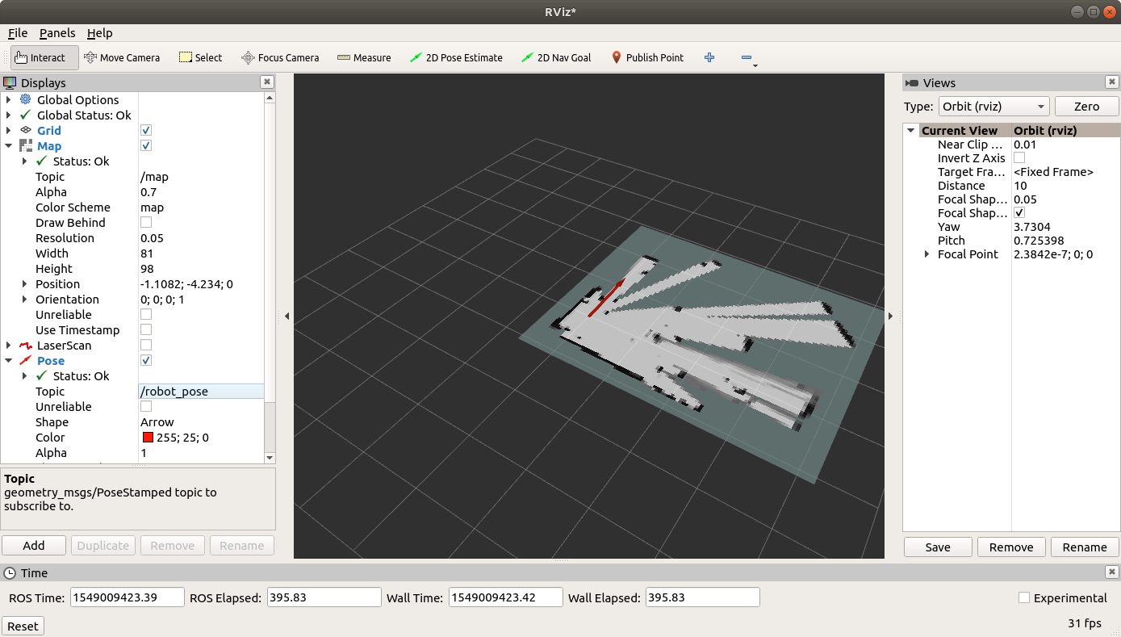
SIMULATION
Lidar integration
Page - 04

Slide 5
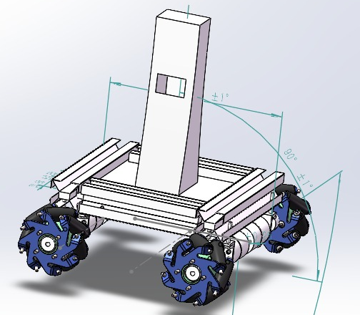
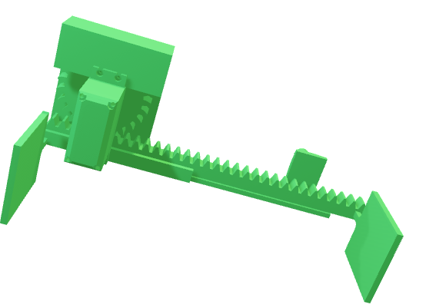
CAD Modelling
Modification on the Existing model
Designing the Beacon support
Adding components for cursor movement
Assembling the design.
Printing the required CAD model.
​
Page - 05

Slide 6
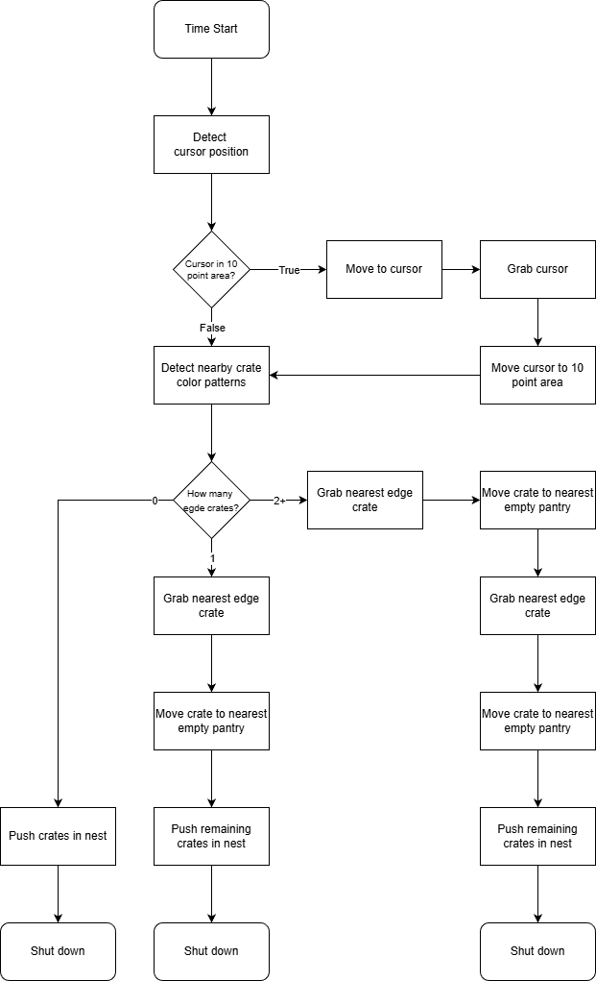
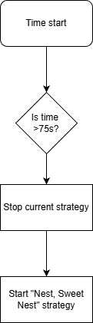
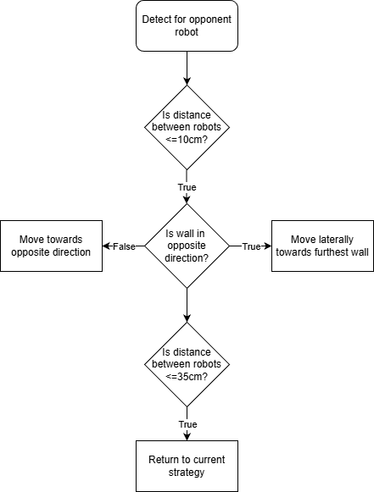
STRATEGIES
Nest, Sweet Nest & parallel routines
Let’s keep the hazelnuts warm
Not too cold, not too warm
Nest, Sweet Nest
Robot detection routine
Timer routine
Page - 06

Slide 7
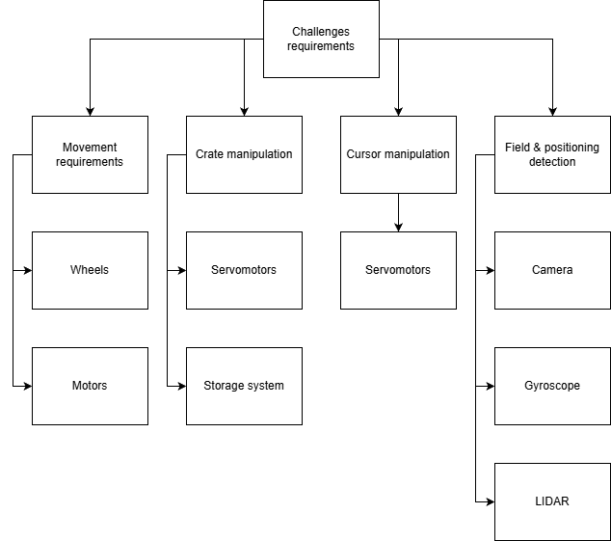
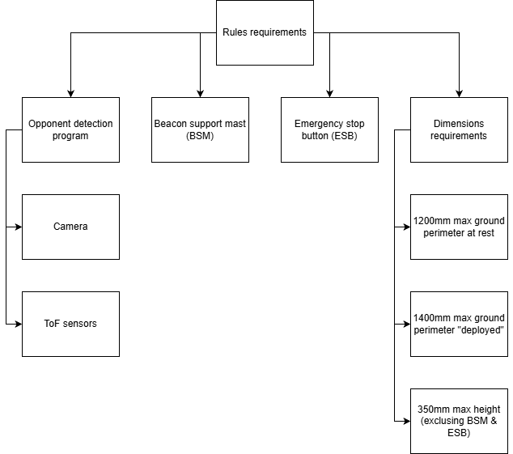
EUROBOT 2026– ROBOT CHECKLIST
Robot requirements
Page - 7

Slide 8
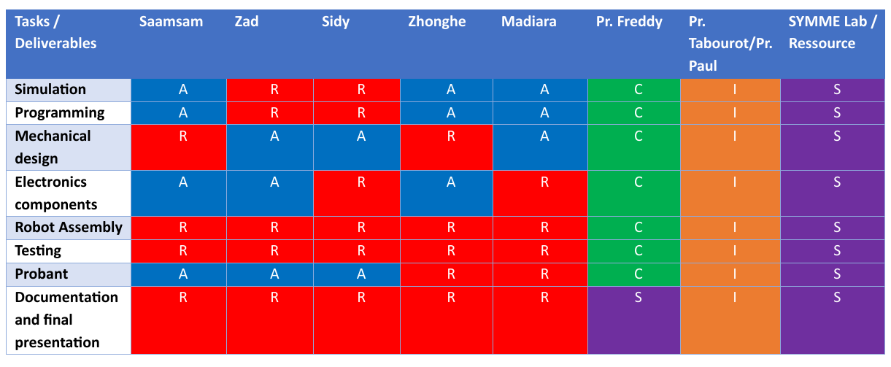
PROJECT MANAGEMENT
RASCI
R: Responsible, A: Accountable, S: Support, C: Consulted, I: Informed
Page - 8

Slide 9
Eurobot 2026– design checklist
Core geometry
Start perimeter ≤ 1200 mm ( from robot’s top view)
Deployed perimeter ≤ 1400 mm during the match
Height ≤ 350 mm at all times (E-stop may reach 375 mm).
Add a beacon support platform at 430 ± 5 mm above the field (this mast is excluded from the 350 mm height).
Platform must be convex, 70–100 mm across, Velcro hook on top, able to support ≥ 400 g, and located near the robot’s center.
Power & pneumatics
On-board voltage ≤ 48 V DC (or 48 V p-p AC) Only unmodified commercial batteries
Compressed air ≤ 4 bar
Page - 06

Slide 10
Eurobot 2026– design checklist
Safety & devices
Mandatory E-stop: red, ≥ 20 mm diameter, top or easily accessible side; stops actuators immediately.
Avoidance system is mandatory (detect/avoid opponent robots). Non-functional avoidance → point loss; deliberate deactivation → disqualification.
Reserve a 100 × 70 mm flat area on a side face for official stickers.
Start device must be a ≥ 500 mm pull-cord trigger (no remote toggles).
Match flow (for planning & testing)
Prep time: 3 min on table; match: 100 s; at T=100 s actuators must stop.
Page - 06

Slide 11
Electrical Section
Page - 05

